Slide 1
KARMA AND GENES : LIFE BUILDING COMPONENTS
Presented by
Prof. (Dr.) Sohan Raj Tater
Former Vice Chancellor,
Singhania University, Rajasthan
Organizer
NEW DELHI

Slide 2
Spirituality (combination of spirit and karma śarīra) and genes
The advantage we have today is that our understanding of genes is growing so quickly. Understanding of genes does not mean resigning overselves to some programmed fate. This is a tool for liberation, a scientific window into the soul. Yes, we are born with a certain genetic make up. No, that does not mean we have no control over our lives. Neither scientists, nor observant parents, really believe we are born as completely blank states to be filled in by our upbringing. The key is the interplay between the hardware we are born with and the software we add. It is not nature or nurture. It is both nature and nurture. In fact, it is part of our nature to respond to nurture.

Slide 3
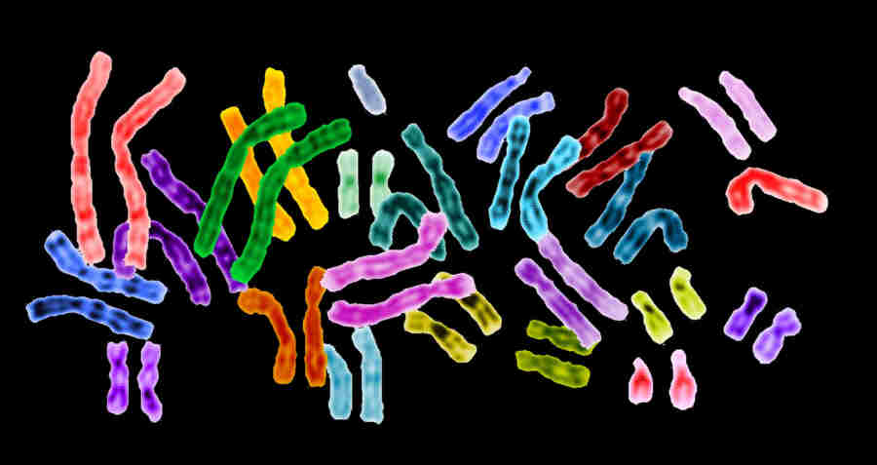
The essence of spirituality, which can include a belief in God or higher power or a divine order of the universe, is looking inward, searching for meaning and purpose, and seeking to understand what truly matters. People turn away from materialism in search of inner peace, through identification with God or with the cosmos. Is spirituality simply an adaptive response, a self deception to deal with old age, infirmity and death? Or is it wisdom, a gradual realization of the real truth about the universe? A scientist might wonder whether spirituality was not written into our genetic codes. Perhaps, as the body begins to expire, the brain wires a new set of neuronal connections in the cerebral cortex that allows us to accept the end with grace, dignity and even hope. On the other hand, this may be a lot of mumbo jumbo, a far too clinical explanation for what we know as the soul with subtle body (karma śarīra).

Slide 4
Prominent geneticist, Cloninger found another thing that seems to increase with aging: spirituality. Not only that, but spiritual people are relatively more likely to express warmth, altruism, positive emotions and openness to feelings. They are relatively more intimate and friendly, they are generous, and concerned with the welfare of others. They also tend to be more optimistic about life and more likely to experience positive emotions such as love and happiness. Above all, spiritual people are open to their own inner feelings and emotions. They experience happiness and joy—as well as pain and suffering—with heightened intensity.

Slide 5
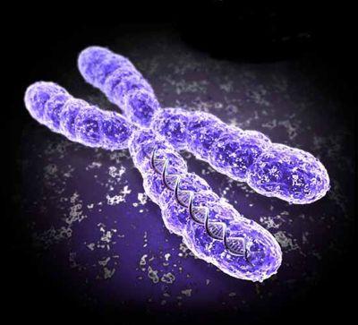
The God Gene Theory
Why is spirituality such a powerful and universal force? Why do so many people believe in things they cannot see, smell, taste, hear or touch? Why do people from all walks of life, around the globe, regardless of their religious backgrounds or the particular God they worship, value spirituality as much as, or more than pleasure, power or wealth? It is argued that the answer is hardwired into our genes. Spirituality is one of our basic human inheritances. It is, in fact, an instinct.

Slide 6
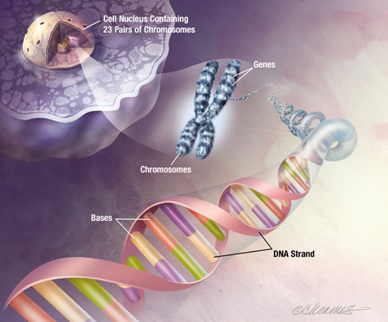
The reason a sparrow sings the song of a sparrow, and not of a robin or a lark, is that it has the genes and brain of sparrow, not that it was raised by sparrow. Moreover, there is a dedicated brain circuit for song. In the God gene, it is proposed that spirituality has a biological mechanism akin to bird song, albeit a far more complex and nuanced one: that we have a genetic predisposition for spiritual belief that is expressed in response to, and shaped by, personal experience and the cultural environment. These genes act by influencing the brain's capability for various types and forms of consciousness, which become the basis for spiritual experiences.11

Slide 7
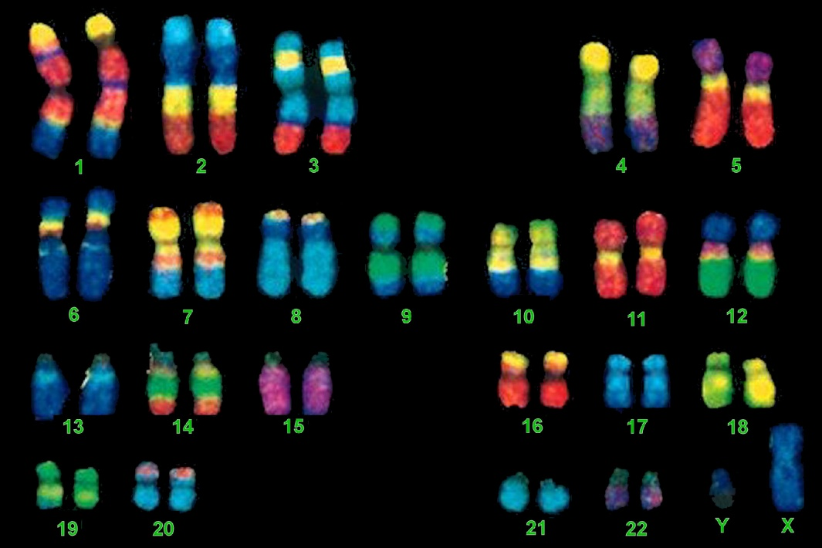
The first task for any scientist attempting to link genetics to spirituality is to show that spirituality can be defined and quantified. This is essential for any scientific analysis, regardless of the topic. Scientists measure things. If we cannot measure it, we cannot test a hypothesis about it, and if we cannot test a hypothesis about it, it cannot be proved. Our major new finding revealed in "The God gene " is our discovery of a scientific individual gene associated with the self transcendence scale of spirituality. This "God gene " codes for a monoamine transporter—a protein that controls the amount of crucial brain signaling chemicals. Interestingly, those same brain chemicals can be triggered by certain drugs that can bring about mystical like experiences.

Slide 8
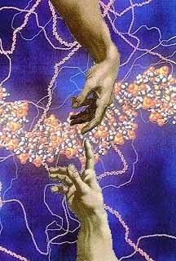
The specific gene (God gene) identified the entire story behind spirituality. It plays only a small, if key, role; many other genes and environmental factors also are involved. Nevertheless, the gene is important because it points out the mechanism by which spirituality is manifested in the brain. One of the important roles that God genes play in natural selection is to provide human beings with an innate sense of optimism. At the psychological level, optimism is the will to keep on living and procreating, despite the fact that death is ultimately inevitable. At the physical level, studies show that optimism seems to promote better health and quicker recovery from disease, advantages that it would help us live long enough to have and raise children and pass on our genetic heritage.

Slide 9
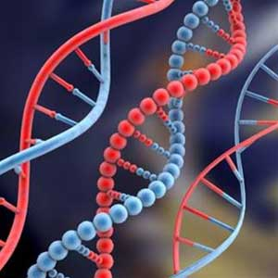
Self Transcendence and Genes
Of course statics alone cannot tell us what that common root is. It could be the result of a gene. But it could equally well be the result of an environment or culture. Self transcendence is, so far, the simplest way we have to measure spirituality. One reason for confirming the validity of the self-transcendence scale was that we wanted to measure individual differences in spirituality and correlate them with genes. It was also important, however, to know if there were any group differences in the scale, because these would complicate and possibly compromise the genetic analysis. Our data base of 1388 subjects allowed us to examine the relationship between self transcendence and three potentially important demographic variances—race, age and gender.

Slide 10
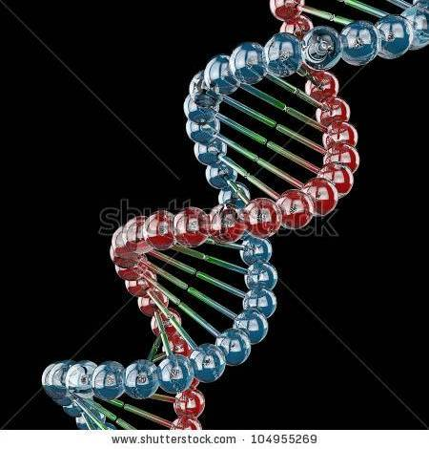
A statical analysis showed that the higher scores of women could not be accounted for any of the other personality factors we measured. It might be something to do with the fact that women are more willing to express their feelings than men or perhaps there is something about our society that brings out the spirituality in women. Or it might have something to do with their genes, a possibility we would later have a chance to test experimentally. Although statistics cannot tell us what spirituality is or is not, or where it comes from, it can help measure spirituality in individual and conform its uniqueness. In a study of the connection between genes and spirituality, that is a good place to start.

Slide 11
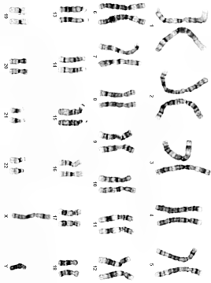
Unlike most young children, Jane and Rose loved going to church, not just on Sunday but during the week as well. They both decided as teenagers to devote their lives to the church and took their vows together. Sister Jane Frances and Sister Rose Marie are nuns at the same convent in Akron, Ohio. In addition to their mutual interest in God and spirituality, Jane and Rose have another important similarity: their DNA. They are identical twins—the product of the same fertilized egg. Twins, especially identical ones like Jane and Rose are fascinating. There is something mysterious and alluring about people who look and sound identical. But identical twins are more than curiosities. Because they share identical DNA, for scientists they offer a way to dissect the role of genes and environment in complex human characteristics like spirituality.

Slide 12
The main use of twins in behavior genetics research is to determine heritability, which is defined as the percentage of variation in a behavior that is due to genetic differences. Heritability can most directly be measured by comparing identical twins who were separated at birth and raised apart. Because such twins have the same genes but are raised in different environments, the extent to which they are similar to each other is a direct approximation of heritability. The degree of similarity can be calculated as a correlation.
The result of their study were consistent, for every scale examined, genes seemed to play an important part. The calculated heritability's were all between 41 and 52 per cent, meaning that genes were responsible for roughly half of the variation in religious belief from one twin to next. In other words, the study seemed to suggest that at least part of the reason people believe that religion can help answer life's questions in their DNA.
In other words, nearly half of the reason that the twins felt religion helped them, spent time privately praying and head a sense of God's presence was inherited. Since these twins were raised by different parents, in different neighborhoods, and sometimes even in different religions, their similarities seemed to be the result of their DNA rather than their environment. Something in their genes helped push them towards religion.

Slide 13
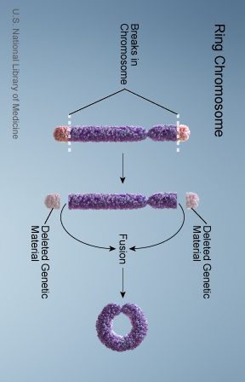
How did the researchers conduct their studies? First they evaluated the data, using a modeling technique that took into account three main sources of variation in self transcendence: genetic influences and shared environmental influences. The first two factors make twins alike, the third makes them different. The analysis indicated that genes are responsible for 48 per cent of the variation in self transcendence in twins, both male and female. The remaining 52 per cent of variance was due to environmental factors for females. Age also had an effect, in males it accounted for four per cent of variance (environmental factors accounted for the other 48 per cent). The researchers also examined the data by a statistical technique called "multivariate modeling." Once again, they found that genes played an important role in self-transcendence.

Slide 14
Using this analysis, the estimated heritability's were 37 per cent for men and 41 per cent for women, which are similar to the numbers obtained in the first analysis. The take home lesson from the Martin and Evas study was clear: genes are a major factor in self transcendence. In other words, spirituality is in good measure an inherited trait. This was a surprising result. The implication is that spirituality, at least as measured by self transcendence, does not result from outside influences. Contrary to what many people might believe, children don't learn to be spiritual from their parents, teachers, priests, imams, ministers or rabbis, nor from their culture or society. All of these influences are equally shared by identical and fraternal twins who are raised together, and yet the two types of twins are strikingly dissimilar in the extent to which they correlate for self transcendence. In other words, William James was right: spirituality comes from within. The kernel must be there from the start. It must be part of their genes.

Slide 15
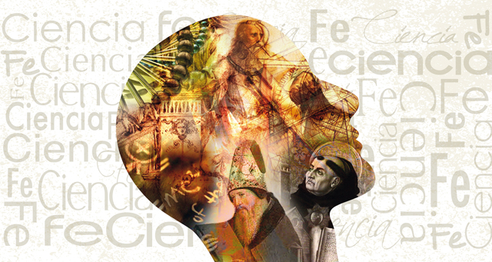
Maslow, Cloninger and many others before them and since have argued that spirituality and religiousness are fundamentally different. The twins studies, by looking quantitatively at both qualities in a single population, strongly support and distinction. More important, they tell us something about why they differ. Religiousness as measured by church attendance is learned in the classical sense—from parents, teachers, religious leaders and seers. People go to the Church or mosque or temple because that is what they were told to do?
Spirituality, as measured by self transcendence, is more innate. It comes from within, not from without. Of course, spirituality has to be developed, just like any other talent. But the evidence suggests the predisposition is there from the beginning. What makes some siblings, like Tenkai and his brother, so spirituality dissimilar despite their common upbringing? And what makes others, like Gloria and Louise, so similar despite their very different life trajectories? Could it be something in their genes? There was only one way to find out.

Slide 16
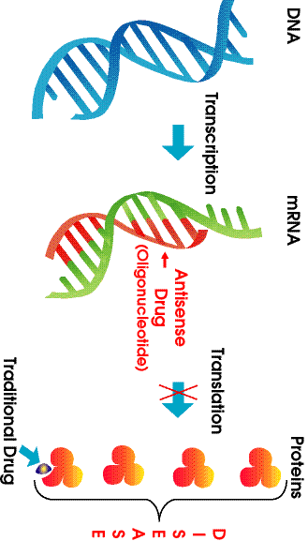
The first gene on the list of candidates was D4DR, which codes for a receptor that senses the presence of dopamine, one of the monoamines in the brain. It was a prime suspect for several reasons. In Comings’ study, dopamine was the neurochemical most strongly associated with self transcendence of all those examined. Comings speculated that this was because the D4DR gene contains an extremely variable repeated DNA sequence that changes the number of amino acids in the protein, which in turn alters the way it works in the brain. Some people have only three copies of this odd sequence: others have as many as eleven copies. D4DR's high association with self transcendence might also be because it is expressed both in the limbic system of the brain—the seat of emotions—and the prefrontal region of cortex—the thinking part of the brain. Moreover, this gene has previously been linked to novelty seeking, a personality trait that is slightly correlated with self transcendence.

Slide 17
There was a clear association between the VMAT2 (on chromosome 10) polymorphism and self transcendence. Individuals with A and C in their DNA—on either of the chromosome or both scored significantly higher than those with an A. The effect was greatest on the overall self-transcendence scale and was also significant for the self-forgetfulness subscale. With transpersonal identification and mysticism, the effect was in the same direction but just short of statistical significance. Somehow, this single base change was effecting every facet of self-transcendence, from loving nature to loving God, from feeling at one with the universe to being willing to sacrifice for its improvement. To delve further into the biology of spirituality, we need to understand more about how monoamines work normally in the brain to produce the greatest hat-trick of biology— consciousness.

Slide 18
Life and Genes
Where there is soul and karma śarīra, life will take birth. Every living organism is built of a number of cells. Where there is cell, means life is there. A cell is made up of genes. That means, where there are genes, ife is there. Soul generates life with the help of karma śarīra. Karma śarīra plays its role in the gross body of a living organism with the help of genes only. Thus, we can say life is a composite building up of soul, karma and genes. Without the soul, karma and genes cannot survive more in gross body of living beings and vice-versa. Thus, life cannot be survived without the common efforts of karma and genes. So we should compare life with genes, i. e. to compare karma wit h genes.

Slide 19
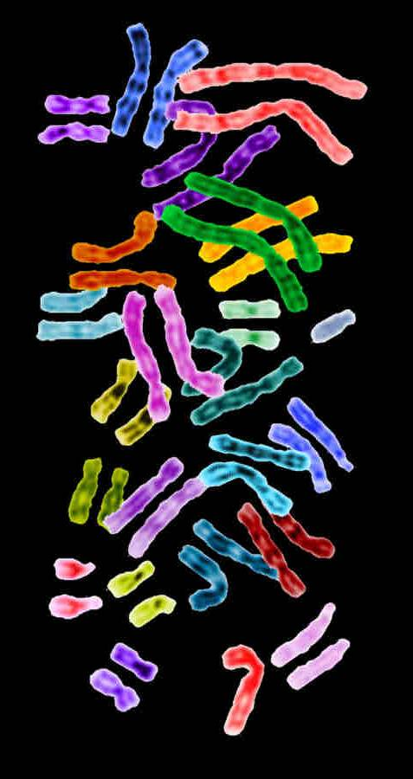
Thinking (Inherting Intelligence) and Genes
The brain begins with genes. Genes, from both parents, combine to design and create the lump of gray flesh in the head, plus the rest of the body, which operates and is operated by the brain. The slightest disruption in the physical development of brain can have a devastating effect on future intelligence. A single glitch in the DNA code can limit mental development or cause severe retardation. On the other hand, "good" genes make the birth of genius possible. There is no single factor more important in an adult's IQ score than genes. However, parents also pass along the environment in which the genes are expressed. What we think about, the language we think in, and how we apply our intelligence, are all products of the environment; how we will think depends very much on that original set of blue prints from the genes. Just like a person who hopes into a car decides where to go and how to get there, the car sets limit on how fast and how successfully.

Slide 20
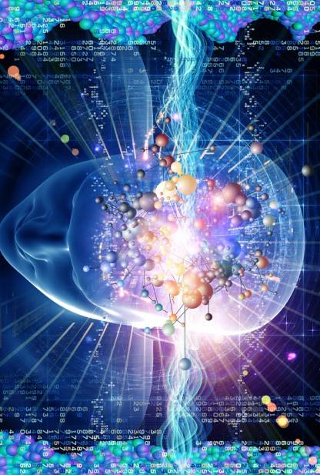
Short term memory is similar to the random access memory (RAM) on a computer; it controls the information needed to run at any given moment. Long term memory is like the hard drive, a repository for all the information needed to operate. Just a computer needs both the RAM and a hard drive, so both short term and long term memory are essential for intelligence. For example, adding the numbers 349 and 217 requires long term memory to remember the rules of addition, and short term memory to execute the specific problem. Memory itself is so in control to the thinking process that memory is one of the best predictors of human intelligence as measured by IQ tests.

Slide 21
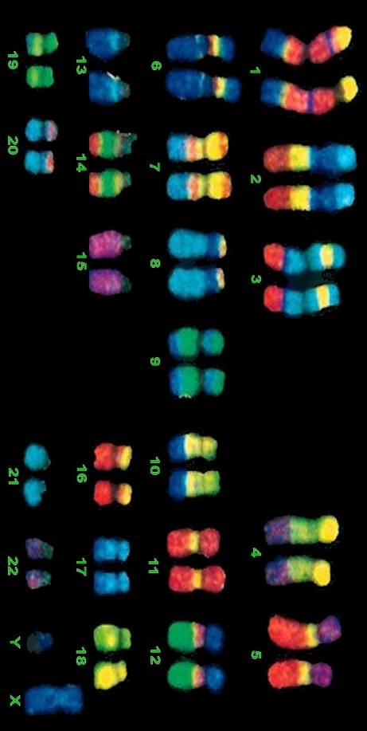
There are two basic types of memory: short term and long term. Short term memory, also known as working memory, operates over seconds where as long term memory lasts for minutes to an entire life. If you hear a random telephone number 441-9620, you might remember it until the end of the sentence, probably not until the end of the paragraph. Your own telephone number, however, is securely stored and easily remembered. The reason is that the random telephone number went into short term memory only, because there was no reason to save it, while your own number is stored in a personal long term vault. How is information in short-term memory converted into long term memory? It must be a selective process. Otherwise, long term memory would soon be swamped with useless information such as restaurant menus, road signs and old TV guides. It would be like the hard drive of a computer that stores every revision of every document, or a radio that records every song. The machinery would soon be filled up with useless, disorganized information, somehow the brain must have a filter to sieve out what needs to be remembered from what can be discarded.

Slide 22
The filter is a physical structure built by genes. It was discovered by studying a simple invertebrate, the sea slug Aplysia. Sea slugs hardly have a brain, and they probably could not pass the bar exam, but they do have a nervous system and are able to 'remember' simple stimuli and respond accordingly, one of the best studied responses is the gill withdrawal reflex. When the gill of a sea slug is touched, the body withdraws into its shell; presumably the touch is a warning that a predator may be nearby. But if the gill is touched repeatedly, the withdrawal response slows down or disappears, as if the sea slug knows that it has nothing to fear. To the extent that intelligence is the ability to adopt behaviour to the environment, the sea slug shows a primitive form of intelligence.

Slide 23
Scientist Eric Kandel wanted to know how the sea slug adopts its response. The first step was to recreate the reflex without the sea slug, using isolated nerve cells grown in a petri plate. By recording the electrical signals between nerve cells, Kandel found that after a single stimulus there is a strong electrical signal at the synapse between nerve cells, but as the stimulus is repeated, the strength of synaptic connection decreases. The nerve cells are "remembering" their past, Kandel showed that the nerve cell 'remembers' by synthesizing a burst of proteins and that the key activator of this explosion of gene expression is a protein called CREB. Kandel proved that the nerve cells could be fooled into thinking they had been stimulated simply by adjusting the amount of active CREB protein.

Slide 24
Geneticist Tully established three things: flies, just like humans, have two forms of memory, short term and long term; short term memory is required to learn the difference between odors, where as long term memory is required to remember the difference and behave accordingly: and that converting short term memory into long term memory requires new gene expression. But what genes were turning on? Taking a clue from Kandel's work on sea slugs, Tully decided to look at the CREB mechanism. The part of the brain responsible is the hippo campus which makes a mental map in minutes and stores it for weeks. Later, if it is an important map, the information is transferred to the cerebral cortex for long term storage. A damaged hippocampus, as can occur from injury or stoke, would prevent a person from finding his way out of a new room, even though he could remember the layout of a place he had lived long before.

Slide 25
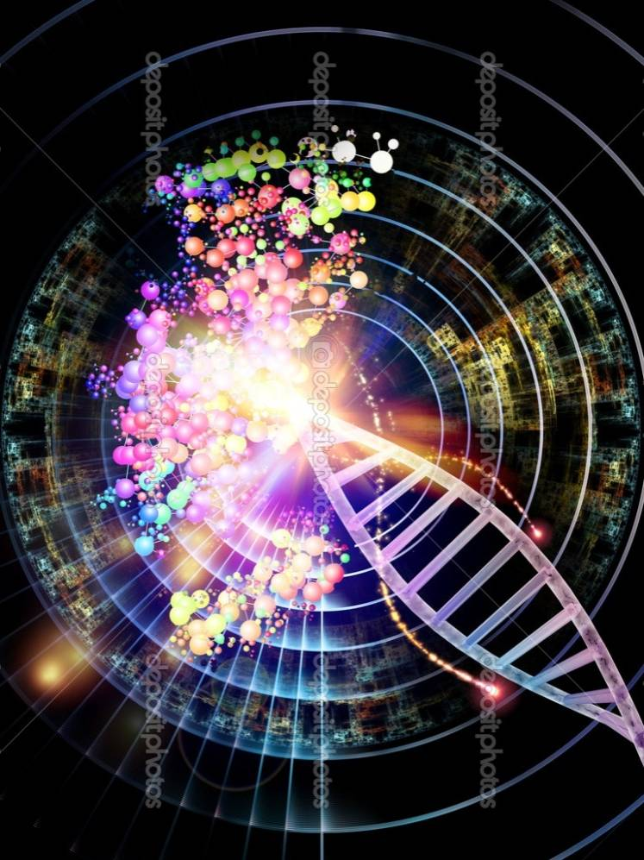
Even though the loss of single gene can prevent a mouse from finding its way, the thought process depends upon more than just genes. A simple experiment showed that experience is important too. Some mice were raised either in a sparse, unfurnished cage with only a water bottle and food tray, while others grew up in a special "play ground" equipped with plastic tubes, a tunnel with multiple openings, and an exercise wheel. After three months the mice brought up in the more stimulating enviroment showed a 15 per cent increase in the number of cells in the hippocampus. The more the mice used their brains to remember the complex topography of the play ground, the better their brain becomes. Even for this simple type of intelligence, environment makes a difference.

Slide 26
What do different people, even when they are brought up the same way in the same environment, get different scores on IQ tests? Although there is no single answer to this question, the results of decades worth of study on tens of thousands of subjectshave been remarkably consistent in showing that the single most important factor is genes. The "environment" includes many factors that influence intelligence, such as prenatal care, nutrition, child care, schooling, etc. Together they are a powerful force, but not one of those environmental factors alone has a great impact than genes.

Slide 27
Conclusion
Where there is soul and karma śarīra, life will take birth. Every living organism is built of a number of cells. Where there is cell, means life is there. A cell is made up of genes. That means, where there are genes, life is there. Soul generates life with the help of karma śarīra. Karma śarīra plays its role in the gross body of a living organism with the help of genes only. Thus, we can say life is a composite building up of soul, karma and genes. Without the soul, karma and genes cannot survive more in gross body of living beings and vice-versa. Thus, life cannot be survived without the common efforts of karma and genes. So we should compare life with genes, i. e. to compare karma with genes.

Slide 28
According to the modern anatomy, all creatures have the same genetic codes—fundamental building blocks of life. It is only due to the mutation of the genetic codes, different types of species of creatures—right from amiba to man, take birth. Thus, the doctrine of Jaina karma believes that all the jīvas are possessed with similar soul and similar capacities but their different karmas provide them different bodies.

Slide 29
Till now the science of genetics has reached only upto genes. It is one of the component units of this gross body, on the other hand, karma is one of the component of our subtle body. Inside this gross body (sthūla śarīra) resides the astral body (taijasa śarīra). The more subtle is the karma body, and it is the most subtle body. At every limb of this most subtle body is written the account of our self-exertion of our virtues and vices, of our limitations and of our reactions. The human starts behaving according to the vibrations coming from karma śarīra. Ācārya Mahāprajña writes, "the genes not only bears the genetic traits of its parents, but these also represent the karmas performed by the individual.

Slide 30
In building personality,karma is not all in all, but heredity, environment, geographical location and ecological conditions all effect nature and behaviour of man. Nāma karmas are not all in all. In facial and body formation of man, effect of the place and time can easily be perceptible on human physique. If two children are born to a mother—the one in some cold country and the other in some hot country, the child born in a cold country can comparatively be more fair than the other child. If some person begins to live in a cold country, his complexion will change. According to Ācārya Mahāprajña, the change of genes and the chemical changes bring change in human personality.

Slide 31
Keeping the genes active or inactive is done by harmones,vitamins, minerals, chemicals and immune system. It is believed that the genes are controlled by the environment around it, cell nutrition wrapped around the genes, and the temperature of the light. Thus, genes are the deciding factors for the various characteristics of a living organism (jīva) and genes are controlled by some known or unknown causes and these causes are certainly the karmas of an individual.

Slide 32
The doctrine of karma conceives karma as constituting a very fine kind of matter aggregates. All living beings of world contain the same genetic codes. This research work bring forth the possibilities that the individual pudgalas (karmic particles or karma varganas) i.e. the karma create genes. Genes and karma both determine the life cycle and inheritance of all living beings. Genetic science says, "we are what because of our genes. Tirthankaras have said since very beginning "we are what because of our karmas". Genes not only bear the genetic traits of their parents but these also represent the karma performed by individual. Karma body possibly controls the activities of the genes. With this research work I arrived at the conclusion that karmas are the cause and genes are their effect (fruits). Karmas direct, instruct, motivate genetic codes and genes to function and mutate accordingly.

Slide 33
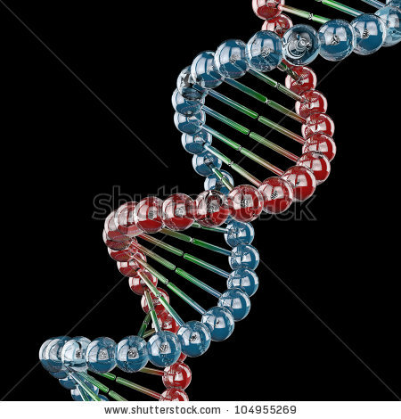
REFERENCES
Rose, Richard J. "Genes and Human Behaviour" Annual Review of Psychology, 46, 625- 54, 1995.
Pomm R., J.R. Nesselroade, "Genetic influence on Life Events During the Last half of the Life span." Psychology and Aging 5, 25-30, 1990.
"The God Gene"—by Dean Hamer—Anchor Books—A division of Random House, Inc., New York (U.S.A.), first edition September, 2005, p. 6-12.
Maslow A.H., "The Core Religious or Transcendent Experience—the Highest State of Cconsciousness," Garden City N.V. Anchor, 1972.

Slide 34
Kirk, K.M., N.C. martin—"Self Transcendence as a Measure of Spirituality in a Sample of Twins," Twin Research 2, 81-87, 1999.
Wright, L. "Twins and What They Tell us About Who We are?New York John Wiley and Sons Inc. 1997.
Waller, N.G., A—Tellegen—"A study of twins reared apart and together" A psycho social, 138-42, 1990.
Joseph, R. "The Transmitter to God, The Limbic System, the Soul and Spirituality" San Jose, CA, University Press California, 2001.
Tully, T. "Regulation of Gene Expression and its Role in Long-term Memory and Synaptic Plasticity"—Proceeding of National Academy of Science, USA, 94, 4239-41, 1997.

Slide 35
THANKS

